Slide 1
Business Fit
1) TURBO CLARIFICATION
Customer Information
M S E C P P
Customer Need
Voice of Customer
Voice of Business
Innovative Adhesive Solution

Slide 2
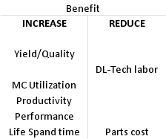
Business Fit
2) TURBO CLEAN
Inspection
Identify 6 big losses
FI : Focus Improvement
Innovative Adhesive Solution

Slide 3
AM
Business Fit
Operator
Kaizen Project
MTBA-MTBF-MTTR
OEE
FI
PM
3) TURBO CARE
Engineer
Technicians
Parts Analysis
TPM
A Tools Modified and
Selected to fit to
each customers as part of
Continuous improvement
Develop Small Group Activity
Education/Training
With concept of pillar AM,FI & PM
Innovative Adhesive Solution

